Slide 1

Infrastructure as Code
Your organization’s Platform Infrastructure SuperPower
(Or how to deploy your Kubernetes cluster in 10 seconds…
the second time)
Prairie Dev Con 2023

Slide 2
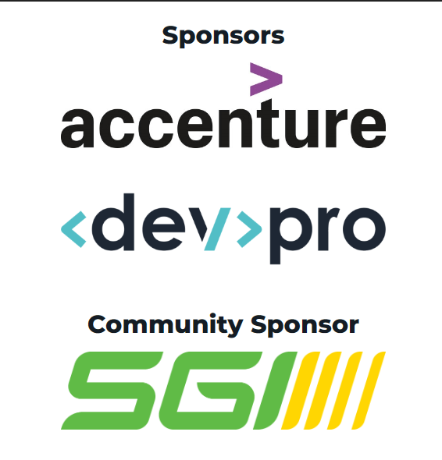
Prairie Dev Con 2023 Regina

Slide 3
Prairie Dev Con 2023 Calgary

Slide 4





Dave White AKT, AKC, PSM, CSM, MVP Alumni
Principal Consultant – Depth Consulting
In technology for over 20 years
Cloud-native, DevOps, Architect, Developer
Kanban/Agile Evangelist, Speaker
WesternDevs member
Alumni MS MVP (2014, 2015, 2016)
http://linkd.in/giMxuw
@AgileRamblings
dave@depthconsulting.ca
https://www.westerndevs.com
https://github.com/agileramblings

Slide 5
Agenda
Why are we here?
Infrastructure as Code (Pulumi)
Top 3 Reasons
Putting it all together
Final Thoughts

Slide 6
Why are we here?
The Platform story we’ve all (probably) heard before

Slide 7
Laugh. Cry. Learn. Share.

Slide 8

There once was an company…
Started in about 1993
Logistics (supply chain) management company
On-prem compute (Windows NT 3.1)
Probably under someone’s desk
In-house developed LOB systems
Windows Domain/Network
File shares

Slide 9

In 2018…
Business has grown to ~$500mm/yr revenue
Data center hardware refresh
Data center needs to be bigger! (yearly??!!?)
Suffered a security breach
In-house development needs are growing
DevOps is desired
Employees want platform innovations
File Shares
In-house DNS
SharePoint
Business Intelligent Suite
Multiple critical LOB systems
Cloud providers can compete on TCO
Complexity of cloud platforms is frightening

Slide 10

Oh.. btw...
A van hit a power pole down the street and killed power and internet access to the building for > ½ a day

Slide 11
Options
Re-build data center, keeping everything in-house ($$$)
Add capacity for growing business needs ($$$$)
Replicate data center in co-location for redundancy ($$$$$)
Outsource majority of platform maintenance and expertise ($$$)
- or -
Get better at managing infrastructure in the cloud ($$)
Retain platform expertise ($$) to maintain business agility

Slide 12
Pros/Cons - DIY Data Center
It’s what we are comfortable with
We’ve been doing it for years
We have the maximum amount of control
Cost certainty (within provisioned capacity)
Building and maintaining is costly
Not good for transient/ephemeral demand
Hard to expand
Vulnerable to a force of nature
Hard to keep platform modern (secure enough?)

Slide 13
Pros/Cons - Cloud
All hardware problems are not our problem
Very good for transient/ephemeral demand
Very easy to expand
Less vulnerable to a force of nature (wait… but wait…)
Provider does a lot to keep the platform modern and secure
We aren’t comfortable with this new tech
We’ve never done this
We will lose control
Cost certainty? What cost certainty?
The cloud is way more complicated!

Slide 14
We were moving to the cloud.
Btw… we want to be cloud-native too!
The cloud is _not_ just a data center.

Slide 15
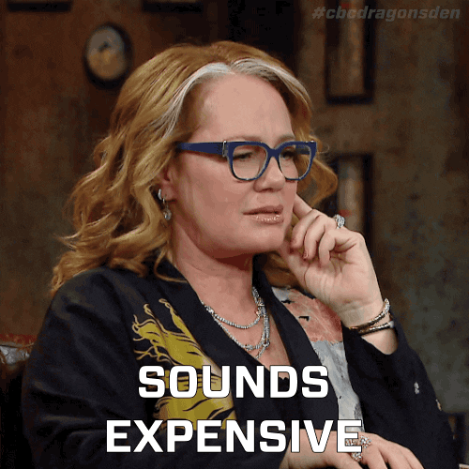
Lift and Shift!!
Let’s have a vendor run a bunch of automated tools that move our data center into Azure!!

Slide 16

What is all this stuff?
The cloud is not your former data center

Slide 17
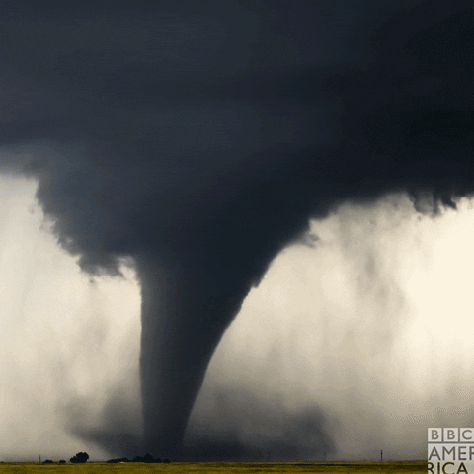
What about redundancy?
Nature happens

Slide 18
How good do we need to be at what we do?

Slide 19
Infrastructure as Code
Take control of what you provision and when

Slide 20
IaC has been around for a long time. Scripts, batch files, daemons… running on Joe’s computer down the hall.

Slide 21
Infrastructure as Code
… our platform is a part of our product as much as our software is
… we understand best what our software needs
… provides an approach to modelling our platform and infrastructure in a code (or code-like) fashion
… gain access to coding practices (version control, pipelines)
… treats the cloud as an API
… captures organizational knowledge

Slide 22
Pros/Cons
PROS
Automation and Efficiency
Scalability
Version Control
Consistency
Reproducibility
Security and Compliance
Cost Optimization
Faster Time to Market
DevOps and Collaboration
Easier Disaster Recovery
Portability
Documentation
ConS
Complexity
Human Error in Code
Version Control Issues
Security Risks
Overhead and Learning Curve
Infrastructure Drift
Vendor Lock-In
Testing Challenges
Initial Investment
Tool and Ecosystem Changes
Resistance to Change

Slide 23
Whoa whoa whoa!!
Dave’s Top 3 reasons to use IaC

Slide 24
Top 3 Reasons I think you should do IaC
Institutional knowledge
Collaboration
Repeatability

Slide 25
Picking a IaC Technology
You always have other options.

Slide 26
The world is your oyster!

Slide 27
Available Options
Pulumi
Terraform
AWS CDK (Cloud Development Kit)
Bicep
Home-grown scripts (ARM + Powershell)

Slide 28

Multi-Language Support
Declarative and Imperative IaC
Cloud Provider Agnostic
Resource Abstraction
Real Programming Constructs
Staging and Preview Environments
State Management
Custom Providers
Integration with CI/CD
Infrastructure as Code Repository
Community and Ecosystem
https://www.pulumi.com/

Slide 29
Top 3 Reasons I think you should do IaC
Institutional knowledge
Collaboration
Repeatability

Slide 30
Warning!!! There is no free lunch. Unicorns aren’t real. That $5 under your pillow isn’t from the tooth fairy.

Slide 31
Document your tools. Educate your peers. Collaborate. Iterate.

Slide 32
Reason #1 – Institutional Knowledge
What is _our_ platform composed of?
What do _we_ do to provision our platform?
How do _we_ put our applications into our platform?
How do _we_ retain everything we’ve learned? What do we mean by _WE_ and _OUR_?

Slide 33
Demo

Slide 34
Reason #2 – Collaboration
How do _we_ ensure this information is democratized?
How do _we_ ensure our experts are included?
How do _we_ ensure our decisions are vetted? Who are _WE_???

Slide 35
Demo

Slide 36
Reason #3 – Repeatability
How do _we_ do this again without making mistakes?
… with a different person/team/group doing it?
… 6 months after we did it last time?

Slide 37
Demo

Slide 38
Bonus Reason #4 – Automation
How do _we_ do this in 10 seconds?
… automagically?

Slide 39
Demo?

Slide 40
Final Thoughts
Some of mine, some of yours

Slide 41
My thoughts
IaC is an important capability to invest in a business’s ongoing growth in maturity
Your platform is a crucial part of your customers’ satisfaction
It will differentiate you from your competitors
IaC isn’t as hard as you think
Owning a platform is (and always was) a very hard problem
A robust culture of IaC + DevOps makes it easier

Slide 42
Questions
Technical questions?
Usage concerns?
Adoption concerns?

Slide 43
Resources
https://github.com/agileramblings
IaC
Pulumi – https://www.pulumi.com
Terraform - https://www.terraform.io/use-cases/infrastructure-as-code
Amazon – https://aws.amazon.com/cdk/
Microsoft
Bicep - https://learn.microsoft.com/en-us/training/paths/fundamentals-bicep/
ARM - https://learn.microsoft.com/en-us/dotnet/architecture/cloud-native/infrastructure-as-code

Slide 44

Thank you
dave@depthconsulting.ca

